Slide 1
Part A: Theoretical and conceptual knowledge  A3 Numerical groundwater flow modeling  A3.2 Conceptual Model A3.2.1 General Aspects
Feasibility of Managed Aquifer Recharge – FEMAR
Knowledge Transfer
Dr.-Ing. T. Reimann, Prof. Dr. Rudolf Liedl
Material for self-paced and digitally enhanced self-learning
Course access: LINK

Slide 2
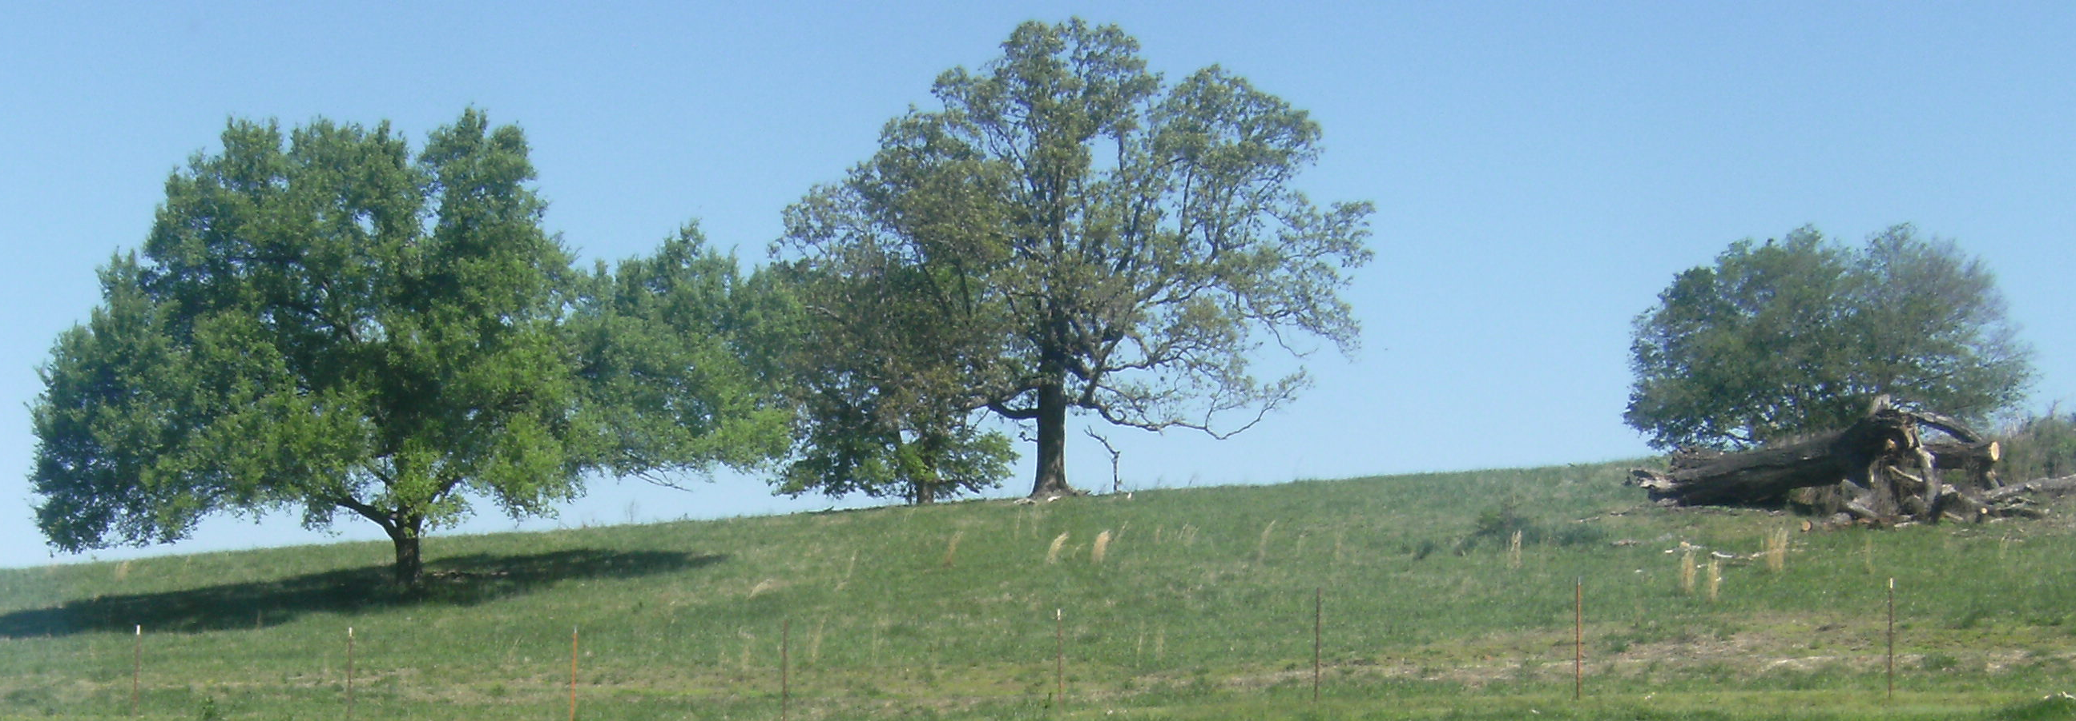
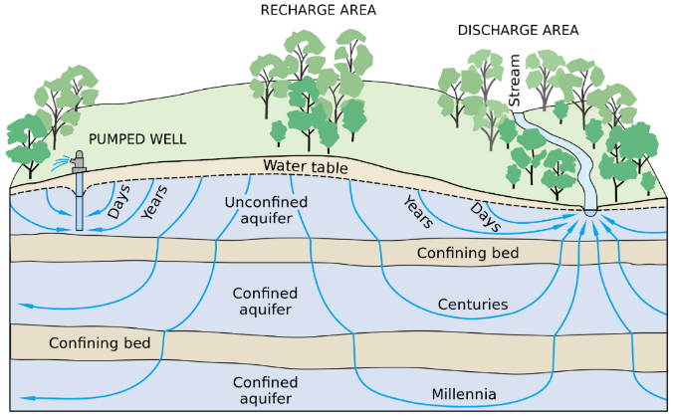
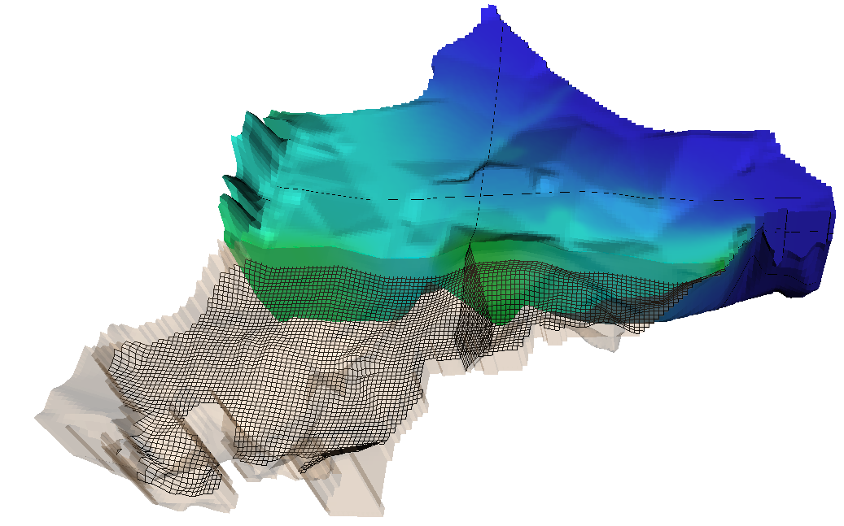
A3.2 Conceptual model A3.2.1 General aspects - Motivation

Slide 3
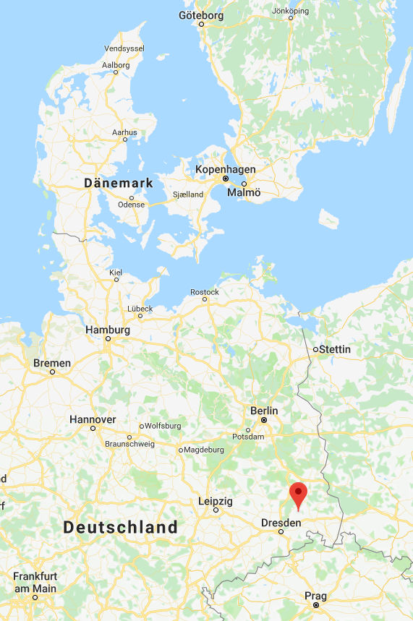
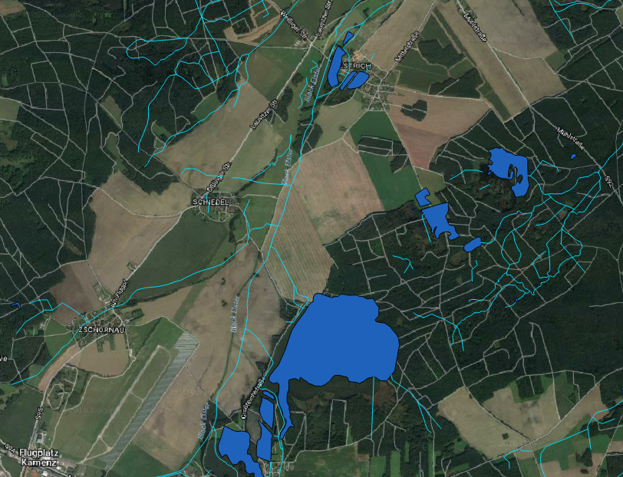
A3.2 Conceptual model A3.2.1 General aspects - Example Water Supply
Notes:
Example: Area intended for groundwater extraction
Interaction of ground- and surface water
Additional: Airport (lower left part) with possible impact on groundwater quality

Slide 4
A3.2 Conceptual model A3.2.1 General aspects - Example Water Supply
Notes:
3D representation of the numerical model (shows grid and heads)

Slide 5
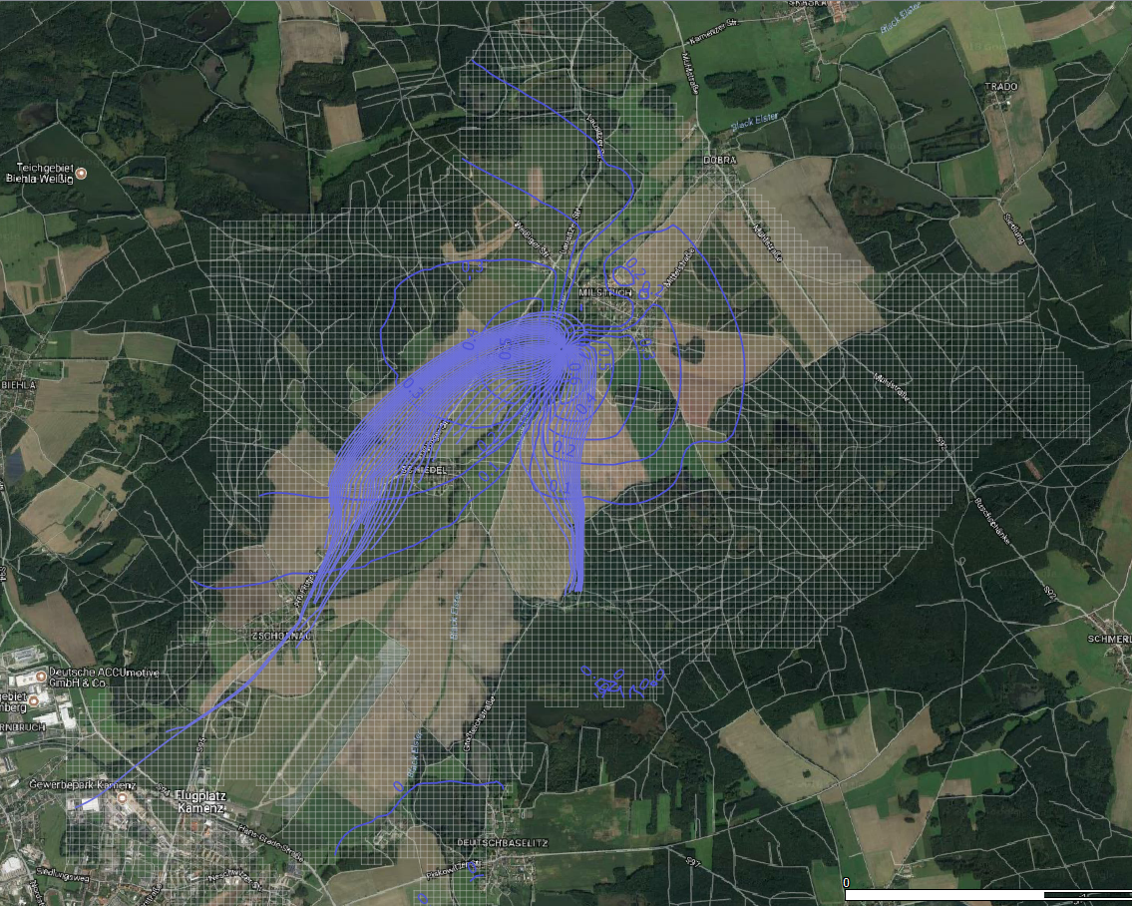
A3.2 Conceptual model A3.2.1 General aspects - Example Water Supply
Notes:
Model results: Pathlines (showing the well catchment area) and drawdown isocontour lines)

Slide 6
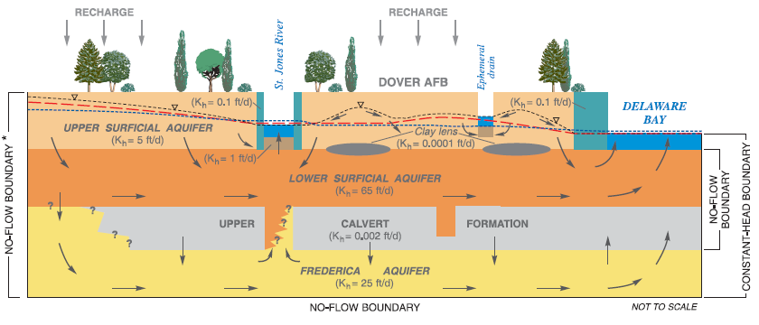
A3.2 Conceptual model A3.2.1 General aspects - Workflow
Figure: pubs.usgs.gov/wri/wri99-4224/pdf/wri99-4224.pdf
Figure from Anderson et al. 2015
Notes:
Deriving a suitable conceptual model is the next step once the question / purpose of modeling is clear
Figure represents an first example of an conceptual model (illustration / qualitative functioning etc.)
See the questions marks in the figure: the conceptual model also identifies uncertainties

Slide 7

5 Quick questions to start with

Slide 8
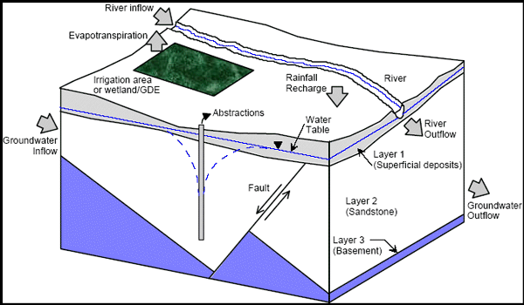
A3.2 Conceptual model A3.2.1 General aspects – The conceptual model
A conceptual model provides a qualitative representation of the relevant system components, processes and impacts in the area of investigation.
(Middlemis, 2001: Groundwater flow modelling guideline)
Notes:
One criterion for model classification distinguishes the qualitative from the quantitative description of a real system.
A conceptual model provides a qualitative representation of the relevant system components, processes and impacts in the area of investigation.
This representation is often shown graphically, e.g. as block model (see below), horizontal or vertical cross sections.

Slide 9
A3.2 Conceptual model A3.2.1 General aspects – The conceptual model
A conceptual model provides a qualitative representation of the relevant system components, processes and impacts in the area of investigation.
Figure: Example of a conceptual model (USGS WRIR 99-4224)
Notes:
One criterion for model classification distinguishes the qualitative from the quantitative description of a real system.
A conceptual model provides a qualitative representation of the relevant system components, processes and impacts in the area of investigation.
This representation is often shown graphically, e.g. as block model (see below), horizontal or vertical cross sections.

Slide 10
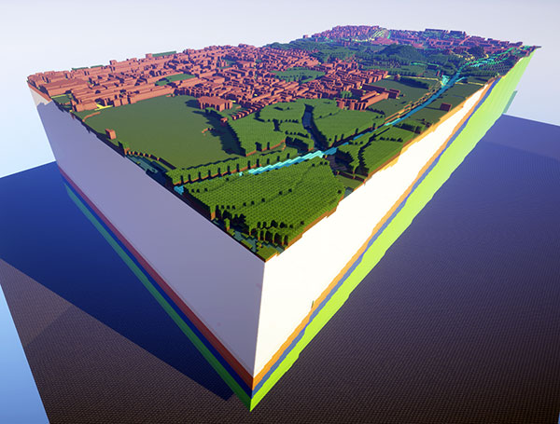
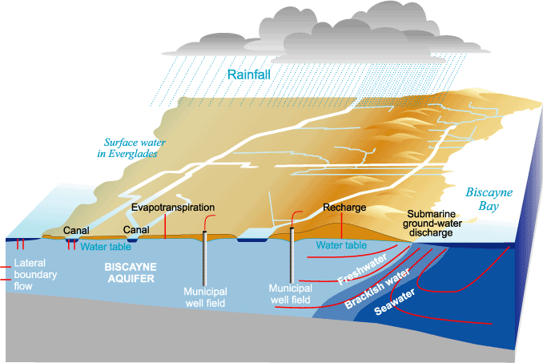
A3.2 Conceptual model A3.2.1 General aspects – The conceptual model
A conceptual model provides a qualitative representation of the relevant system components, processes and impacts in the area of investigation.
Figure: British Geological Survey – West Thurrock
Figure: Example of a conceptual model (USGS WRIR 99-4224)
http://www.bgs.ac.uk/discoveringGeology/geologyOfBritain/minecraft/3d/home.html
Notes:
One criterion for model classification distinguishes the qualitative from the quantitative description of a real system.
A conceptual model provides a qualitative representation of the relevant system components, processes and impacts in the area of investigation.
This representation is often shown graphically, e.g. as block model (see below), horizontal or vertical cross sections.

Slide 11
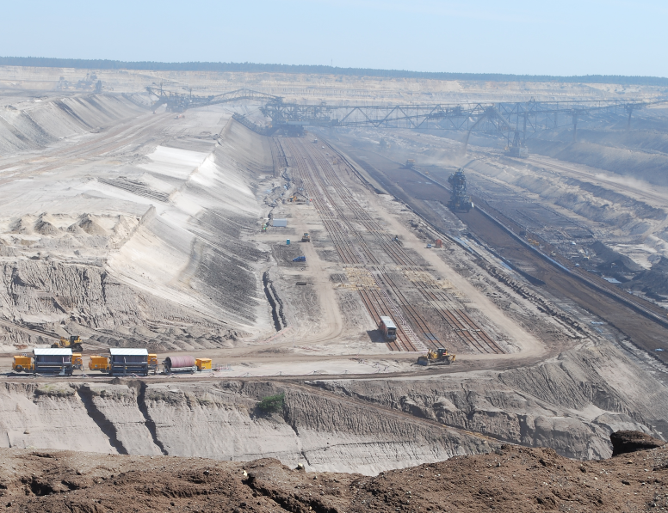
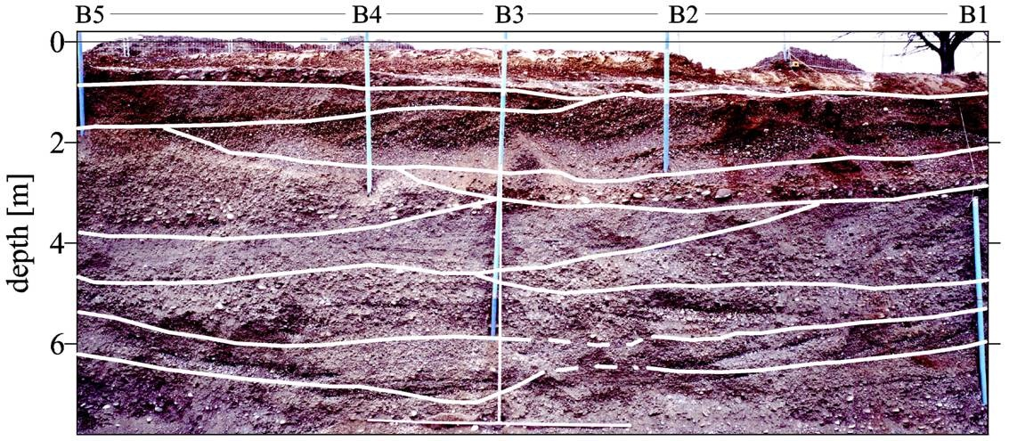
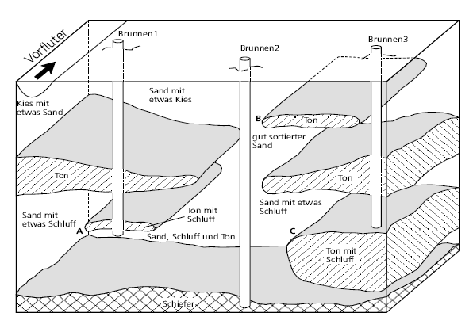
A3.2 Conceptual model A3.2.1 General aspects – The conceptual model
Adequate abstraction of complex hydrogeological settings
 Structures / Boundaries
Reality (usually not visible!) Hydrogeological model
qualitative system behavior / system understanding
prediction of natural / artificial influences

Slide 12
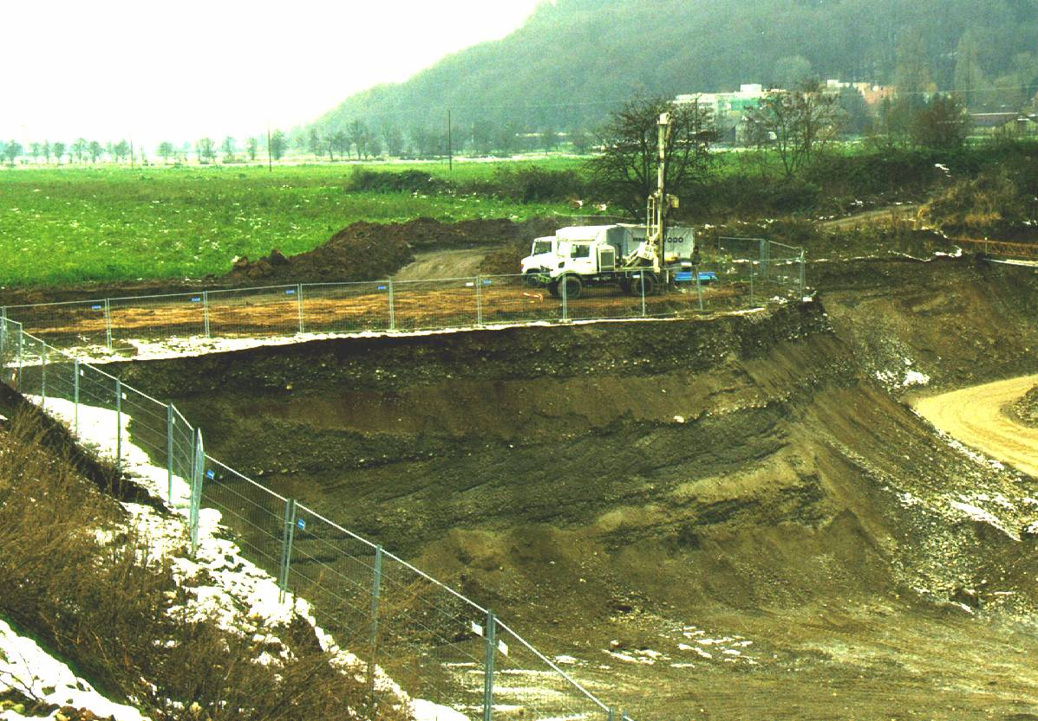
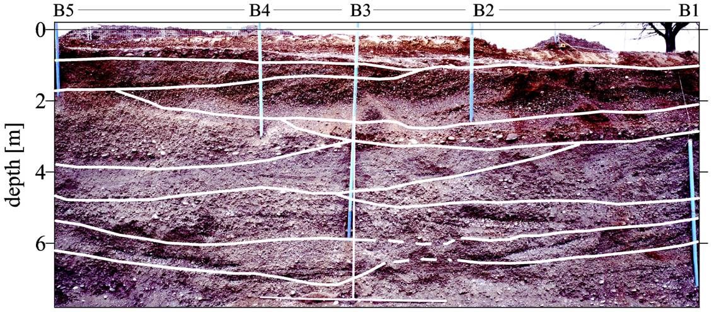
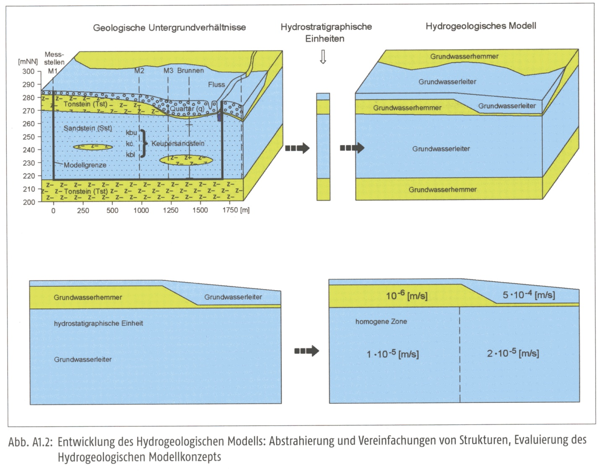
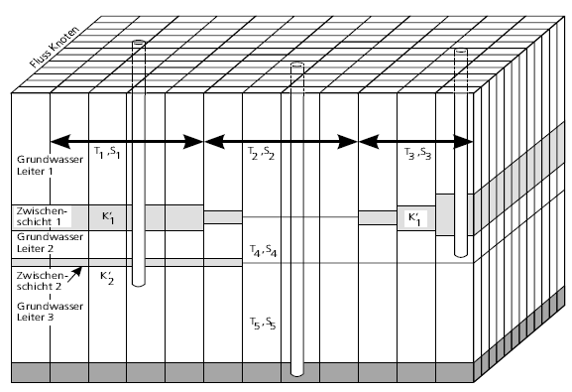
A3.2 Conceptual model A3.2.1 General aspects – The conceptual model
Conceptual Model = problem- and system adequate representation of the nature
Notes:
Descriptive representation of groundwater system incorporating interpretation of geological & hydrological conditions
What processes are important to model?
What are the boundaries?
What parameter values are available?
What parameter values must be collected?

Slide 13
A3.2 Conceptual model A3.2.1 General aspects – The conceptual model
Conceptual Model = problem- and system adequate representation of the nature
Includes
all physically relevant measures (reasonable simplified) regarding time and space
qualitative system behavior / system understanding
suitable abstraction
functional behavior
= often an individual interpretation of existing data & knowledge

Slide 14
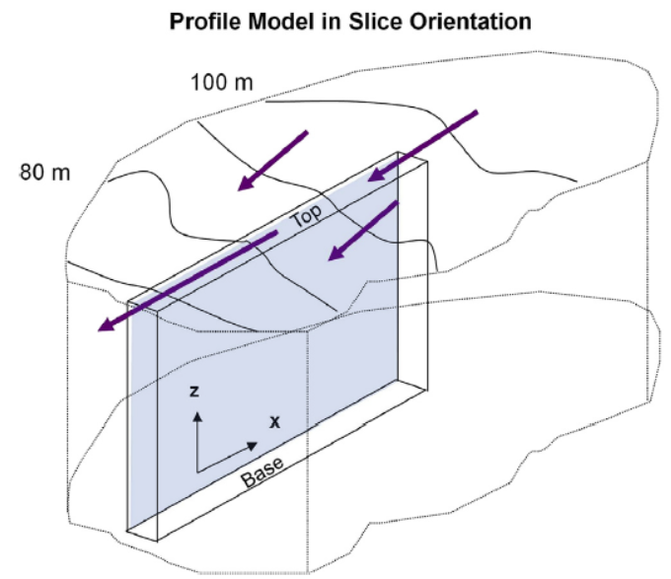
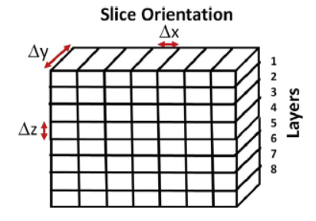
A3.2 Conceptual model A3.2.1 General aspects – Model dimension
(1D)
2D vertical

Slide 15
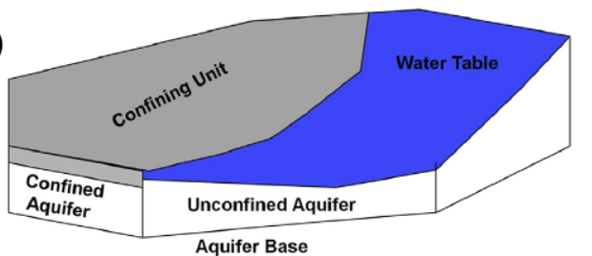
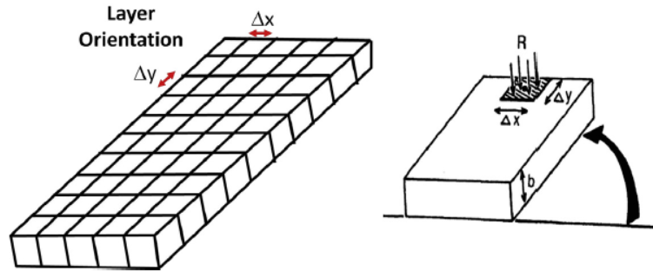
A3.2 Conceptual model A3.2.1 General aspects – Model dimension
(1D)
2D vertical
2D horizontal
Figures from Anderson et al. 2015

Slide 16
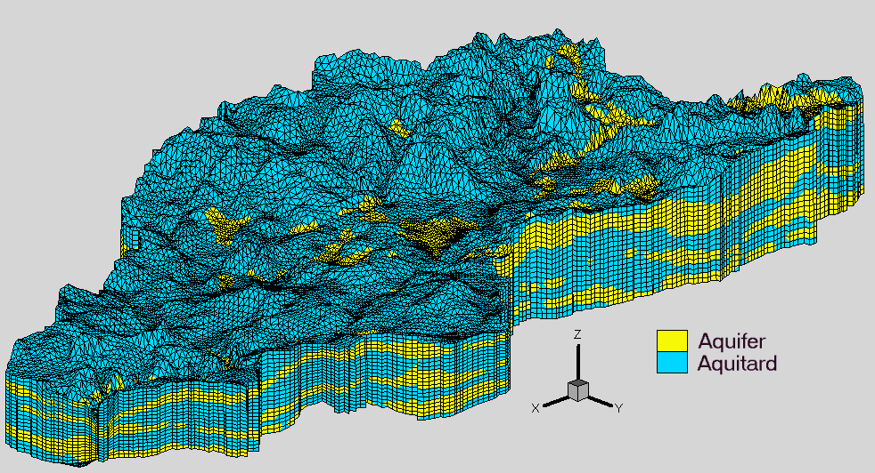
A3.2 Conceptual model A3.2.1 General aspects – Model dimension and time
(1D)
2D vertical
2D horizontal
3D
steady-state
transient
University of Waterloo,
Dept. of Earth Sciences

Slide 17
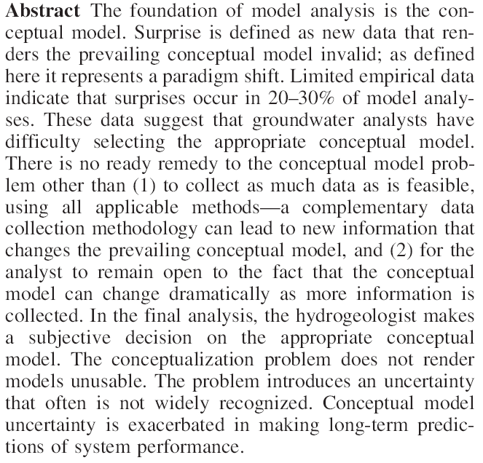
A3.2 Conceptual model A3.2.1 General aspects - Importance of conceptual models
from Bredehoeft (2005):
The conceptualization model problem – surprise
(doi: 10.1007/s10040-
004-0430-5).
Notes:
This abstract from Bredehoeft (2005) highlights the importance of the conceptual model
The conceptual model represents the current state of knowledge
With more data, the conceptual model can change in the future

Slide 18
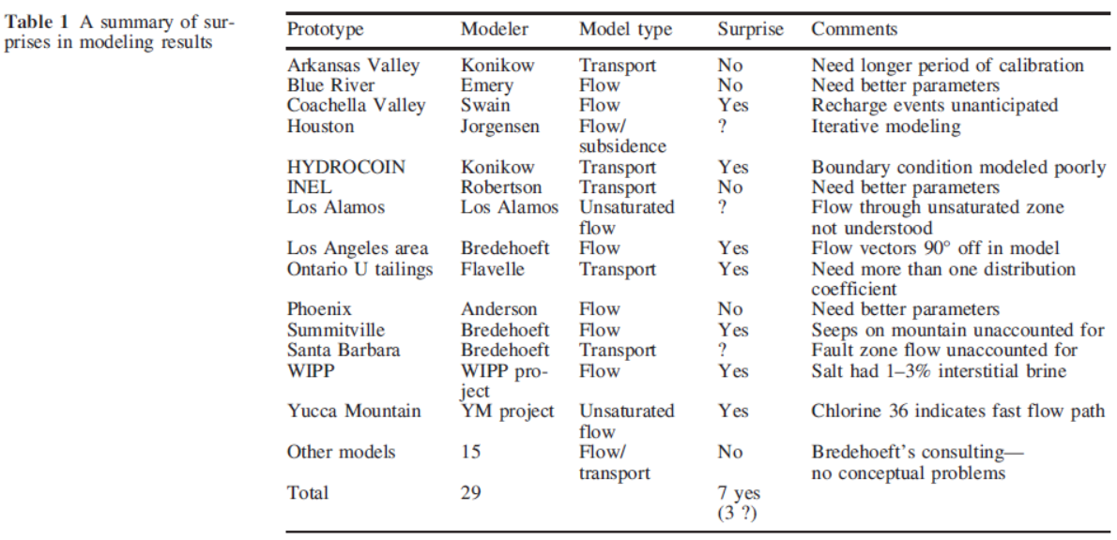
A3.2 Conceptual model A3.2.1 General aspects - Importance of conceptual models
‘Surprise’
Groundwater modeling ‘Superstars’
From Bredehoeft 2005:
The conceptualization model problem–surprise
(doi: 10.1007/s10040-004-0430-5).

Slide 19
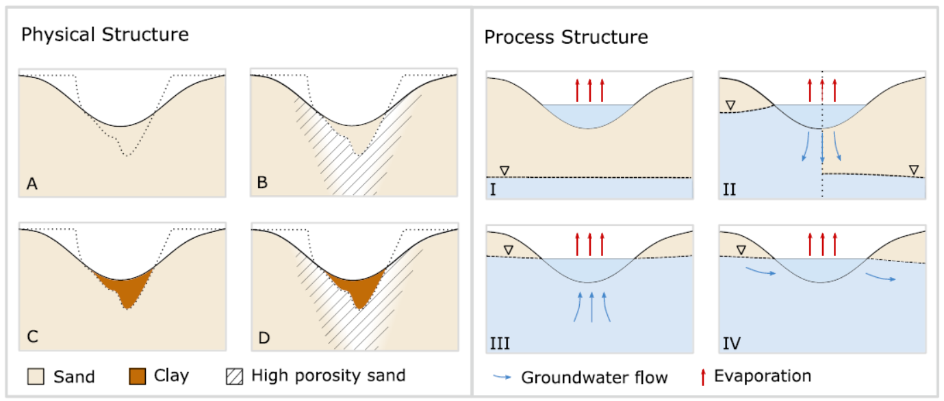
A3.2 Conceptual model A3.2.1 General aspects - Importance of conceptual models
Conceptual uncertainty
Figure from Enemark et al., WRR2020

Slide 20
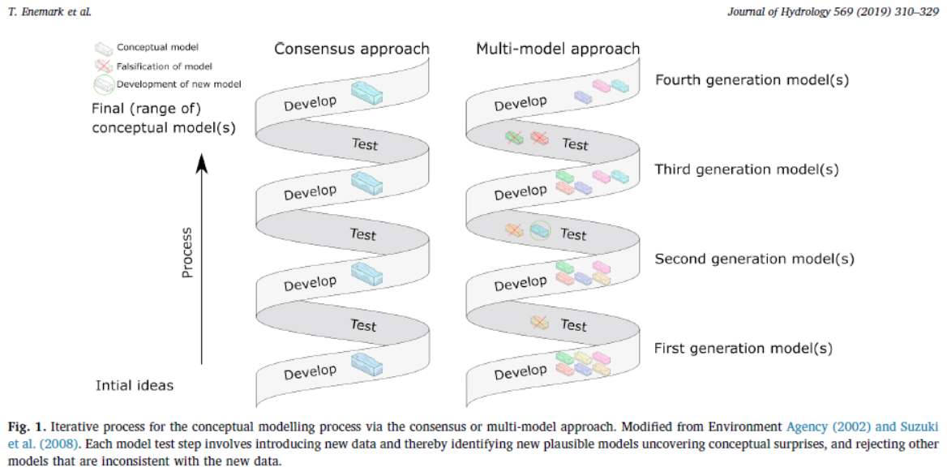
A3.2 Conceptual model A3.2.1 General aspects - Importance of conceptual models
Conceptual uncertainty
Figure from Enemark et al., JoH 2019

Slide 21
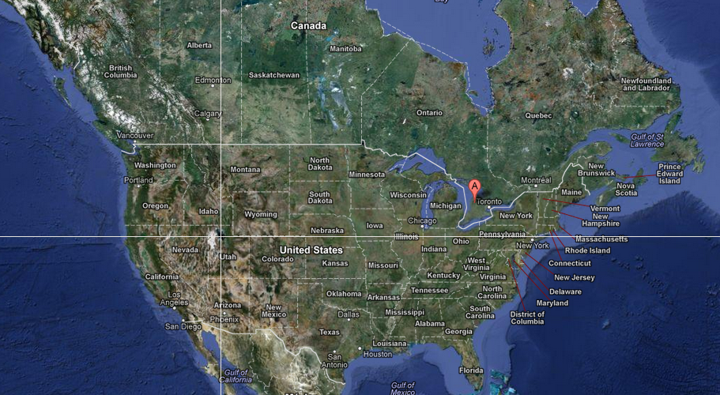
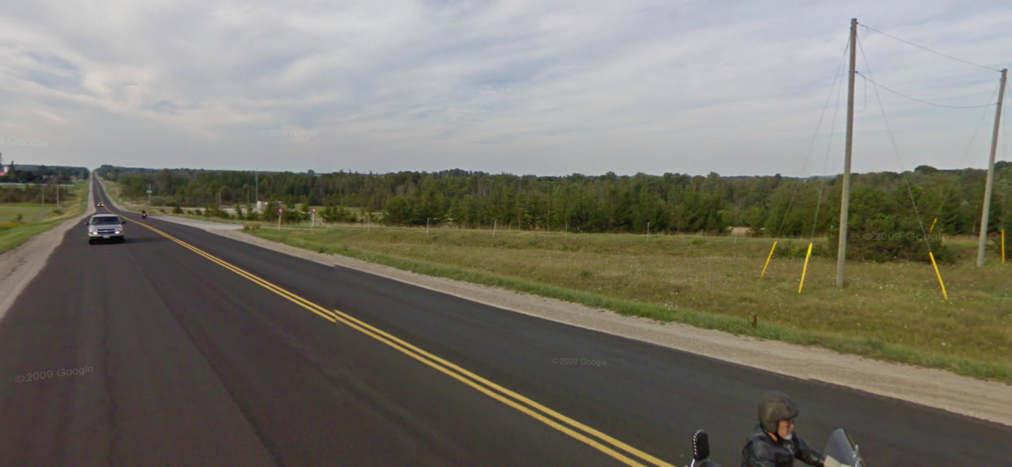
Case Study – Walkerton, Canada I
from Google Maps

Slide 22
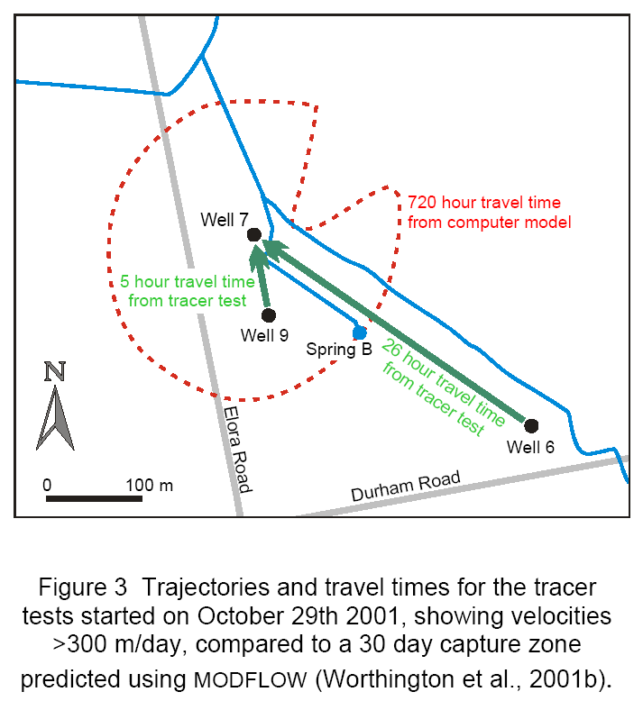
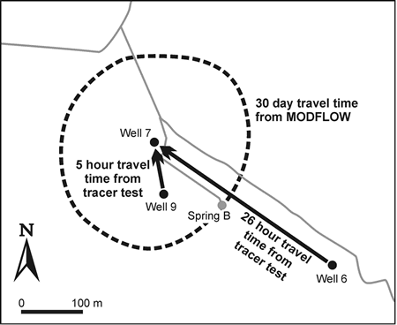
Case Study – Walkerton, Canada V
Further investigations:
karst characteristics
conceptual model needs update (i.e. considering fast water passages along fractures or dissolution conduits in consolidated rock)
Worthington et al. 2002

Slide 23

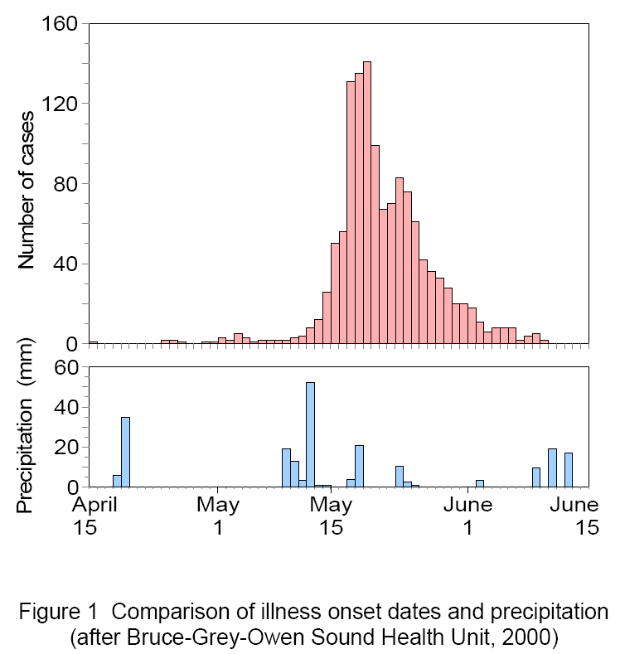
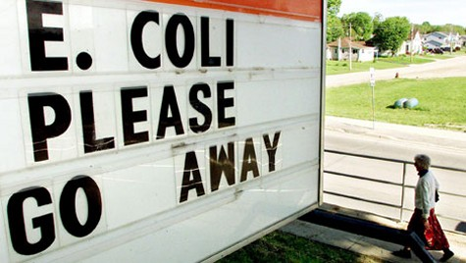
Case Study – Walkerton, Canada II
Worthington et al. 2002

Slide 24
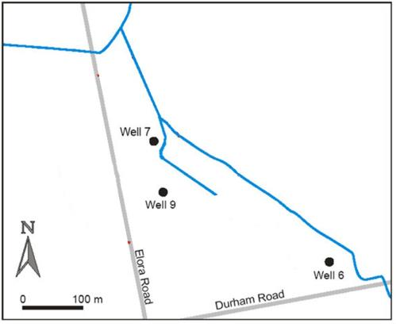
Case Study – Walkerton, Canada III
Delineation of a water protection area (well 7)
from Worthington et al. 2002

Slide 25
Case Study – Walkerton, Canada IV
Results from numerical modeling based on a “simple“ conceptual model (assuming uniform hydrogeological properties)
from Worthington et al. 2002

